Slide 1
Analytics for Customization
Customer Analytics

Slide 2
Agenda
Customization
Next product to buy models
Recommender systems

Slide 3
Customization
So far we’ve talked about analytics as targeting given one offer/ad/intervention
Contact response
Proactive churn management
Another approach is to use analytics to improve relevance of offer, via customization (personalization)

Slide 4
Cross-selling and upselling
Cross-selling
Firm tries to get customer to buy other products of firm that customer does not already own
A bank has a million customers but most use only 1 or 2 of its services
Up-selling
Firm tries to get the customer to buy more expensive variants or add-ons to products
Key challenge: which product to target to which customer?

Slide 5
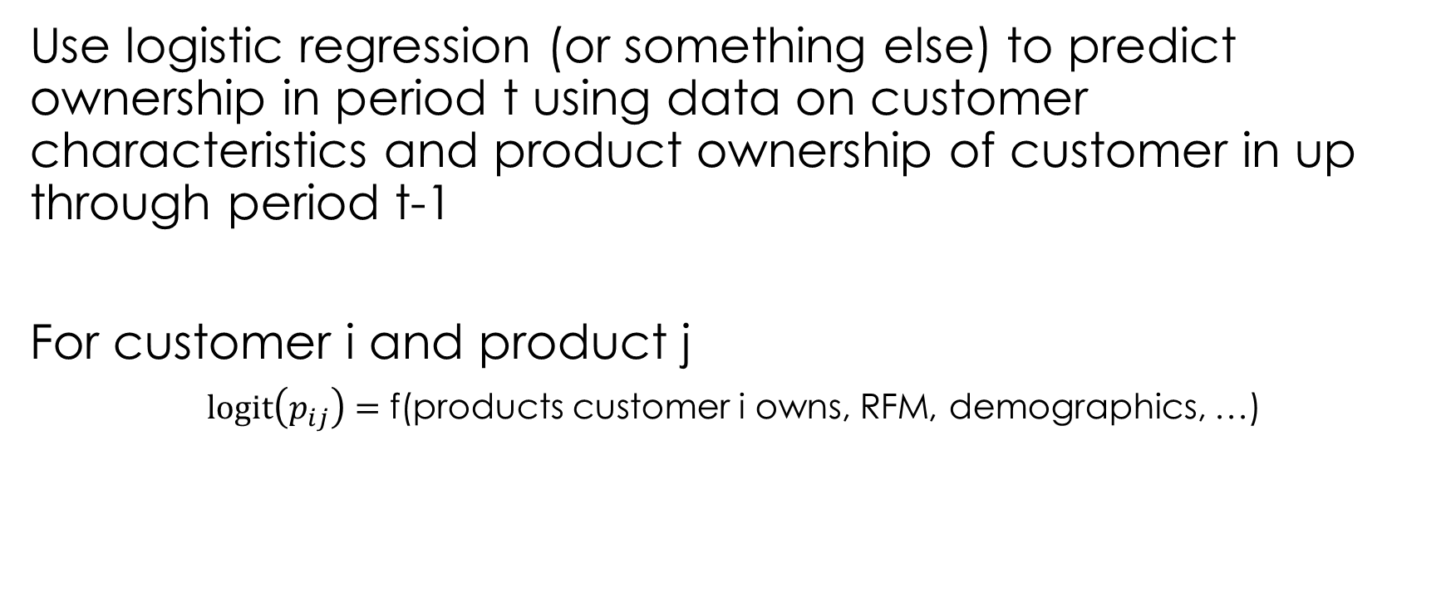
Next product to buy
Use logistic regression (or something else) to predict ownership in period t using data on customer characteristics and product ownership of customer in up through period t-1
For customer i and product j
$\text{logit}\left(p_{ij}\right)=$ f(products customer i owns, RFM, demographics, …)
Product affinity
Next-product-to-buy models for cross-selling applications

Slide 6
Product affinity
CDs (certificate of deposit) is positively related to savings and negatively to checking

Slide 7
Scoring & targeting the rollout customers
Use the estimated model to score the rollout customers
For every customer i and product j in the rollout, you now have a probability
For each product j, order the customers and choose the top X% customers to target

Slide 8
Direct mailing for a loan product
Heuristic: home value > cutoff
Prospect: not current customers
Control response rate: did customer buy without mailing

Slide 9
Extensions
Why recommend a product the customer was going to buy anyhow?
Companies should focus recommendations that increase/lift probability the most (Bodapati 2008)
Customer lifecycle: natural ordering of products (Li et al. 2005)
Campaign-focused, not customer-focused
Want to ensure to long-term financial success (Li et al. 2011)

Slide 10
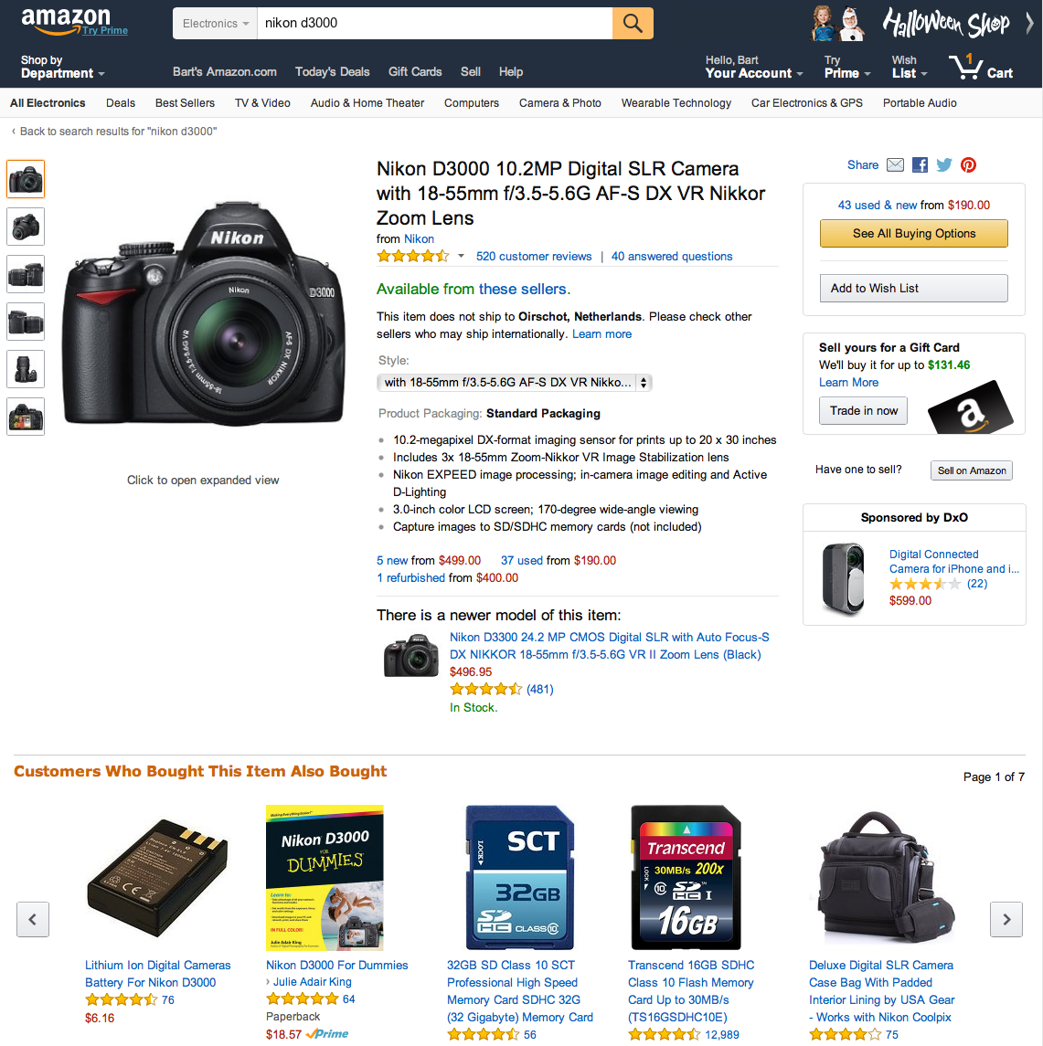
Recommender Systems
Inbound customization
Big data on consumer views, purchases and reviews
Automated big data tools to facilitate customized dynamic recommendations
35% of Amazon revenue originates from recommendation

Slide 11
Examples of markets with many products
Realistic?

Slide 12
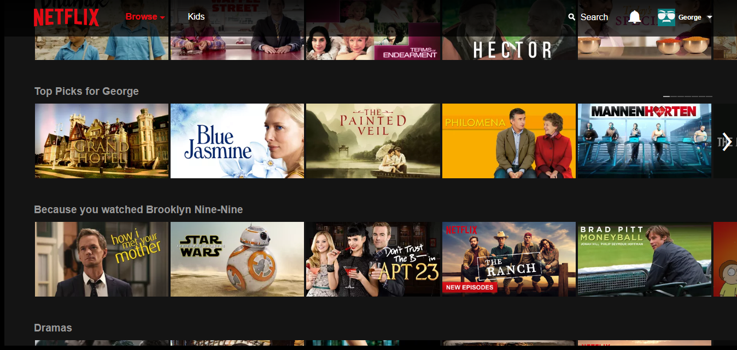
Netflix
75% of Netflix watching is from recommendation list

Slide 13
Recommendation systems
Create automatic recommendations from others’ purchases and reviews.
Content filtering: making recommendations based on observed characteristics of users and products.
Recommend action movie to teenage males
Collaborative filtering: based on similarities between users and products.
Recommend X if liked Y, because others who liked Y liked X
Two generic types: often combination of approaches in real world

Slide 14
Netflix Prize: crowdsourcing RS
2006: Netflix offered $1M to first group that could improve on the predictions by 10%
Stimulated lots of research interest!
100M ratings, 18K movies, 480K users
2009: won by a merger of teams & methods
Winning model: average of 800 different models
“Ensemble approach”: take a bunch of models and average their predictions
Winning the Netflix Prize

Slide 15
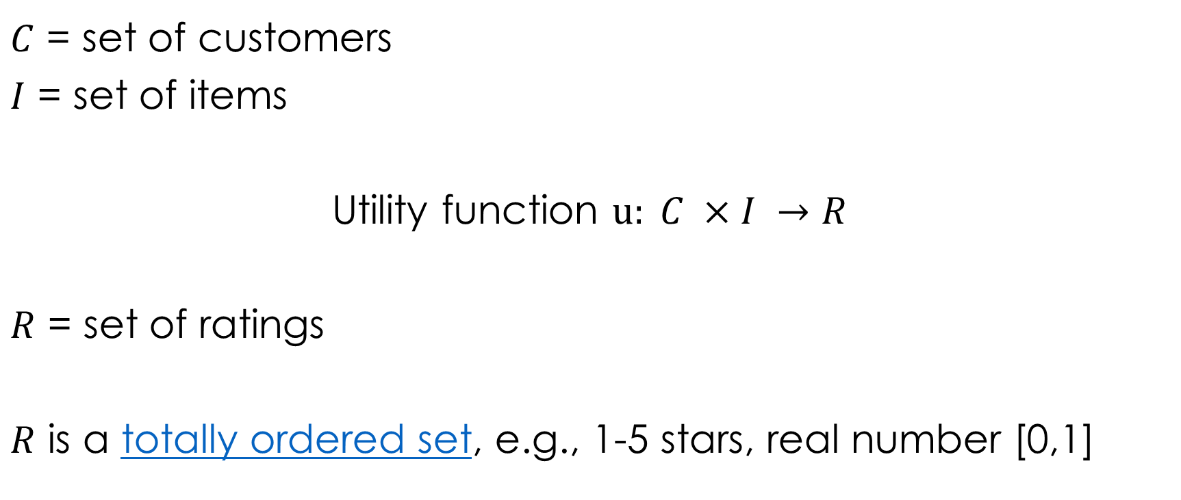
Formal model
$C$ = set of customers
$I$ = set of items
Utility function $u: C ×I →R$
$R$ = set of ratings
$R$ is a totally ordered set, e.g., 1-5 stars, real number [0,1]

Slide 16
Example: Utility matrix
 | Jungle Book | Civil War | Deadpool | Zootopia
Adam | 5 |  | 1
Ben |  | 4 |  | 3
Chris | 2 |  | 4
David |  |  |  | 2
???
???
???
???
???
???
???
???
???
Utility matrix is sparse: most users haven’t rated most movies

Slide 17
Key issues
How do you collect the known ratings for the utility matrix?
How do you predict/extrapolate unknown ratings from known ratings?
Focus on high not low ratings
How do you measure success or performance of the RS?

Slide 18
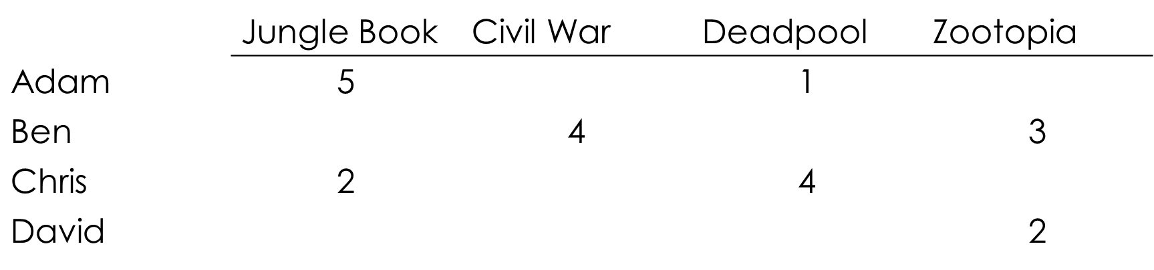
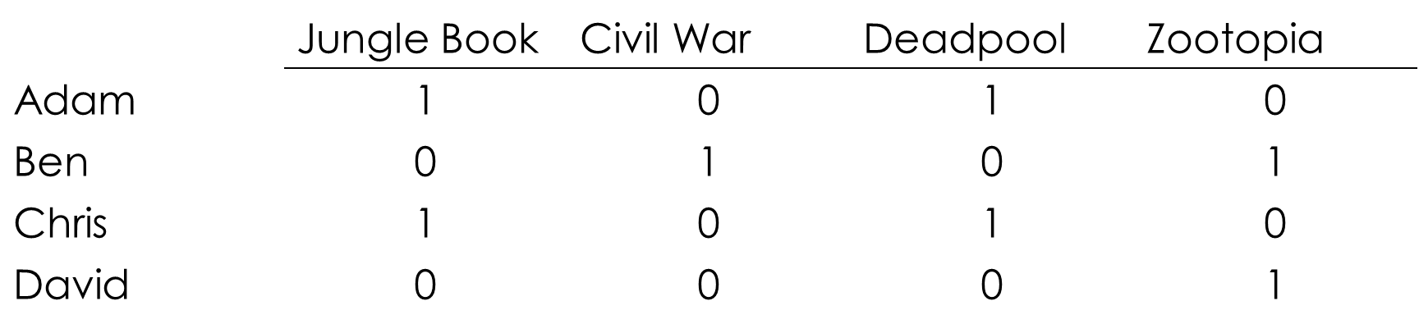
1. Collecting data
Explicit
Implicit
Simple: ask people to rate items
Not scalable: most users don’t leave ratings
Netflix: rate more products so we can improve our recommendations!
Scalable: learn ratings from user actions
Purchase implies high rating
Hard to learn low ratings
Does non-purchase mean not aware or aware but does not like?

Slide 19
2. Predicting utilities
Key problem: utility matrix is sparse
Most people have not rated most items
Cold start
New items have no ratings
New users have no history
Two approaches to predicting
Content-based
Keyword-based profiles and filtering
Semantic content profiles
Collaborative filtering
Correlational (user- or item-based)
Dimensionality reduction

Slide 20
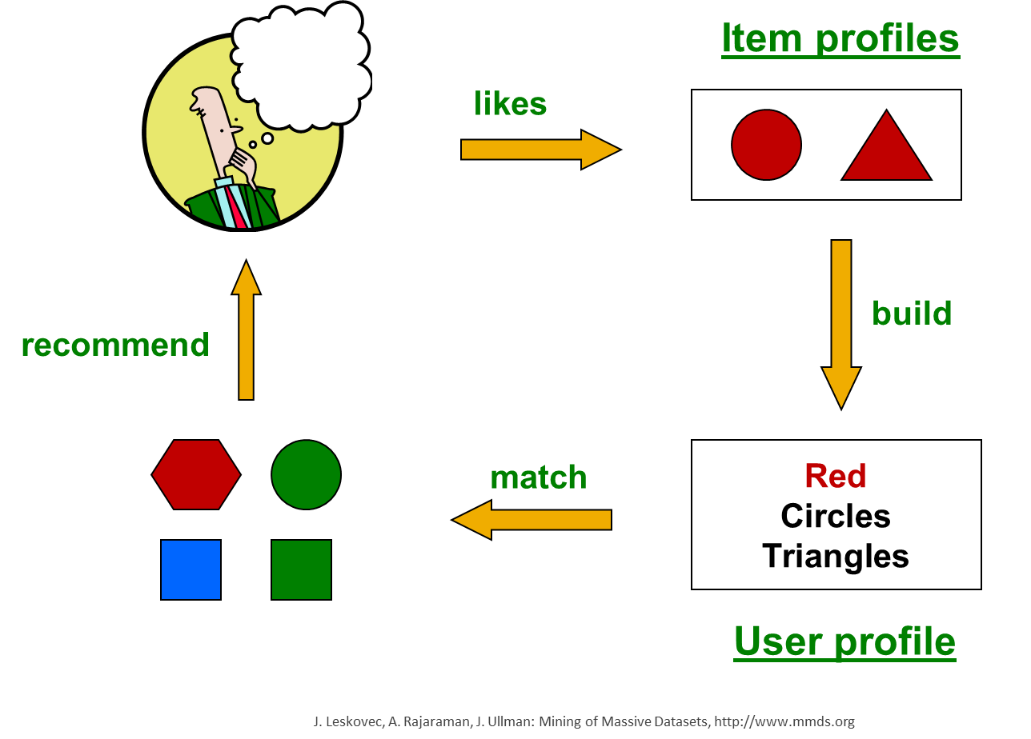
Content-based recommendations
Recommend items to customer similar to previous items rated highly by customer
Recommendation Systems

Slide 21
Building item profiles
Profile is a set of features
Movies: author, title, actor,
Images, videos: metadata, tags
People: set of friends
Think of it as a vector
Item profile #1
Item profile #2
 | Pretty Woman | Total Recall
AS | 0 | 1
JR | 1 | 0

Slide 22
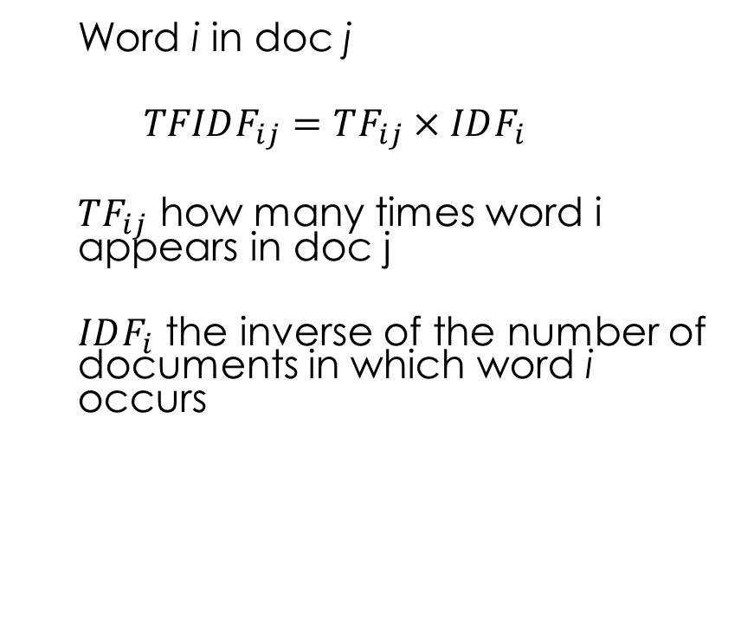
Item profile: incorporating text
Metadata may leave important information out!
Reviews: surprising plot-twist at end!
Profile = set of “important” words in item document
How do you pick important words?
Text-mining: TF-IDF
Term frequency inverse doc frequency
Word i in doc j
$$TFIDF_{ij}=TF_{ij}×IDF_{i}$$
$TF_{ij}$ how many times word i appears in doc j
$IDF_{i}$ the inverse of the number of documents in which word i occurs
 | Pretty Woman | Total Recall
AS | 0 | 1
JR | 1 | 0
“surprise” | 0.1 | 0.4

Slide 23
User Profiles
 | Pretty Woman | Total Recall | Erin Brockovich | Terminator 2 | Predator
AS | 0 | 1 | 0 | 1 | 1
JR | 1 | 0 | 1 | 0 | 0
“surprise” | 0.1 | 0.4 | 0.1 | 0 | 0.1
Adam’s ratings
3 | 1 | 5 | 2 | 4
Adam’s
normalized ratings
0 | -2 | 2 | -1 | 1

Slide 24

User Profiles
AS
0
-2
2
-1
1
0 | 1 | 0 | 1 | 1
$$=−2$$
Inner product of characteristic and normalized review ÷ number of movies with AS
 | Adam
AS | -2/3
JR | 1
“surprise” | -0.5

Slide 25
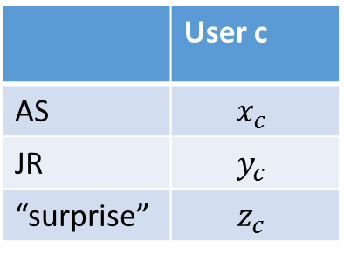
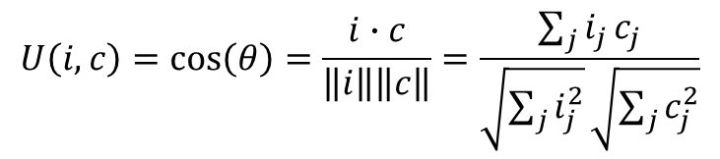
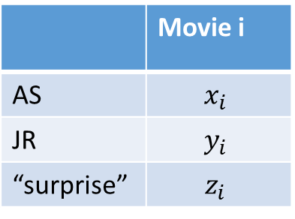



Making predictions
Item profile i, user profile c
 | Movie i
AS | $$x_{i}$$
JR | $$y_{i}$$
“surprise” | $$z_{i}$$
 | User c
AS | $$x_{c}$$
JR | $$y_{c}$$
“surprise” | $$z_{c}$$
$$i$$
$$c$$
$$U\left(i,c\right)=\cos\left(θ\right)=\frac{i∙c}{\left\|i\right\|\left\|c\right\|}=\frac{\sum_{j}{i_{j}}c_{j}}{\sqrt{\sum_{j}{i_{j}^{2}}}\sqrt{\sum_{j}{c_{j}^{2}}}}$$
$$θ$$

Slide 26

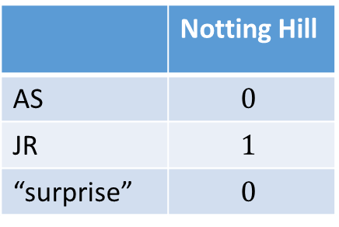
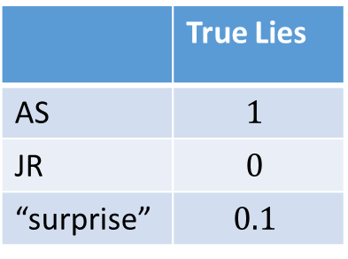
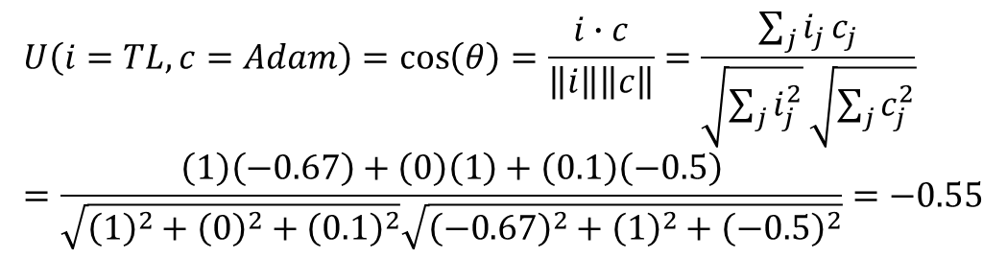
Example: Making predictions
 | True Lies
AS | $$1$$
JR | $$0$$
“surprise” | $$0.1$$
 | Notting Hill
AS | $$0$$
JR | $$1$$
“surprise” | $$0$$
 | Adam
AS | -0.67
JR | 1
“surprise” | -0.5
$$i$$
$$U\left(i=TL,c=Adam\right)=\cos\left(θ\right)=\frac{i∙c}{\left\|i\right\|\left\|c\right\|}=\frac{\sum_{j}{i_{j}}c_{j}}{\sqrt{\sum_{j}{i_{j}^{2}}}\sqrt{\sum_{j}{c_{j}^{2}}}} \\ =\frac{\left(1\right)\left(−0.67\right)+\left(0\right)\left(1\right)+\left(0.1\right)\left(−0.5\right)}{\sqrt{{\left(1\right)}^{2}+{\left(0\right)}^{2}+{\left(0.1\right)}^{2}}\sqrt{{\left(−0.67\right)}^{2}+{\left(1\right)}^{2}+{\left(−0.5\right)}^{2}}}=−0.55$$
$$c$$
$$θ$$
$$U\left(i=NH,c=Adam\right)=0.77$$

Slide 27
Content-based approach
Positives
Negatives
No need for data on other users
Good for unique tastes
Able to recommend new & unpopular items
No first-rater problem
Can explain why something was recommended (JR +)
Finding features is hard
Hard to classify experience goods based on artists, genres, etc.
Overspecialization
Never recommends items outside content profile
People have multiple interests (e.g., multiple users on account)
Cold-start problem for users
How do you build a profile for a new user?

Slide 28
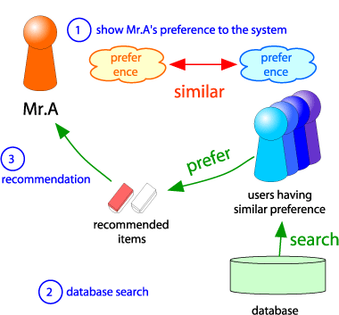
Collaborative Filtering
Consider Mr. A
Find other users whose ratings are similar to Mr. A’s
Estimate Mr. A’s ratings based on ratings of similar users.
(This is called “user-based” collaborative filtering; also item-based)

Slide 29
Understanding the computation
 | Pretty Woman | Total Recall | Erin Brockovich | Terminator 2 | Predator | Notting Hill
Adam | 2 | 5 | 4 | 2 | ? | ?
Ben | 5 | 1 | 2 |  | 1
Cindy | 5 | 5 | 5 | 5 | 5 | 5
Dave | 2 | 5 |  | 3
Emily | 5 | 3 | 5 | 3 |  | 5
Fred | 1 | 5 |  |  |  | 1
George | 2 |  | 5 |  | 5
This is an example of user-based collaborative filtering
Notes:
Fred and George similar; Ben negative; Dave Cindy Emily not useful
Predator good
Notting hill bad

Slide 30
Understanding the computation
 | Pretty Woman | Total Recall | Erin Brockovich | Terminator 2 | Predator | Notting Hill
Adam | 2 | 5 | 4 | 2 | ? | ?
Ben | 5 | 1 | 2 |  | 1
Cindy | 5 | 5 | 5 | 5 | 5 | 5
Dave | 2 | 5 |  | 3
Emily | 5 | 3 | 5 | 3 |  | 5
Fred | 1 | 5 |  |  |  | 1
George | 2 |  | 5 |  | 5
This is an example of user-based collaborative filtering

Slide 31
Understanding the computation
 | Pretty Woman | Total Recall | Erin Brockovich | Terminator 2 | Predator | Notting Hill
Adam | 2 | 5 | 4 | 2 | ? | ?
Ben | 5 | 1 | 2 |  | 1
Cindy | 5 | 5 | 5 | 5 | 5 | 5
Dave | 2 | 5 |  | 3
Emily | 5 | 3 | 5 | 3 |  | 5
Fred | 1 | 5 |  |  |  | 1
George | 2 |  | 5 |  | 5
This is an example of user-based collaborative filtering

Slide 32
Understanding the computation
 | Pretty Woman | Total Recall | Erin Brockovich | Terminator 2 | Predator | Notting Hill
Adam | 2 | 5 | 4 | 2 | ? | ?
Ben | 5 | 1 | 2 |  | 1
Cindy | 5 | 5 | 5 | 5 | 5 | 5
Dave | 2 | 5 |  | 3
Emily | 5 | 3 | 5 | 3 |  | 5
Fred | 1 | 5 |  |  |  | 1
George | 2 |  | 5 |  | 5
This is an example of item-based collaborative filtering

Slide 33
Understanding the computation
 | Pretty Woman | Total Recall | Erin Brockovich | Terminator 2 | Predator | Notting Hill
Adam | 2 | 5 | 4 | 2 | ? | ?
Ben | 5 | 1 | 2 |  | 1
Cindy | 5 | 5 | 5 | 5 | 5 | 5
Dave | 2 | 5 |  | 3
Emily | 5 | 3 | 5 | 3 |  | 5
Fred | 1 | 5 |  |  |  | 1
George | 2 |  | 5 |  | 5
This is an example of item-based collaborative filtering

Slide 34
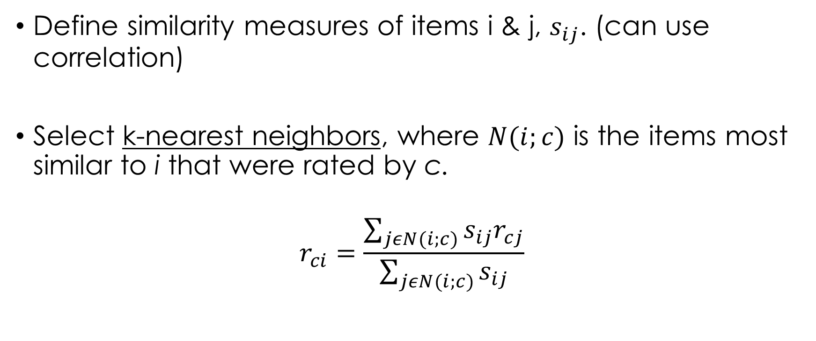
Formal model
Define similarity measures of items i & j, $s_{ij}$. (can use correlation)
Select k-nearest neighbors, where $N(i;c)$ is the items most similar to i that were rated by c.
$$r_{ci}=\frac{\sum_{jεN(i;c)}{s_{ij}r_{cj}}}{\sum_{jεN(i;c)}{s_{ij}}}$$
Why k? computation is expensive!

Slide 35
Item vs. User based CF
In theory, item- and user-based CF are dual approaches
In practice item-based predicts better than user-based
Why? Items are “simpler” than users
Items belong to a small set of “genres”, users have varied tastes
Adam can like baroque organ music and acid rock
A song is unlikely to be to be categorized as both
Item similarity is more meaningful than user similarity

Slide 36
Collaborative Filtering
Positives
Negatives
Works for any kind of item
No feature selection needed
Cold start
Need enough users in the system to find a match
Sparsity
User matrix is sparse
Hard to find users that have rated the same set of items
First rater
Cannot recommend unrated item
New items, esoteric items
Popularity bias
Tends to recommend popular items
“Harry Potter effect”

Slide 37
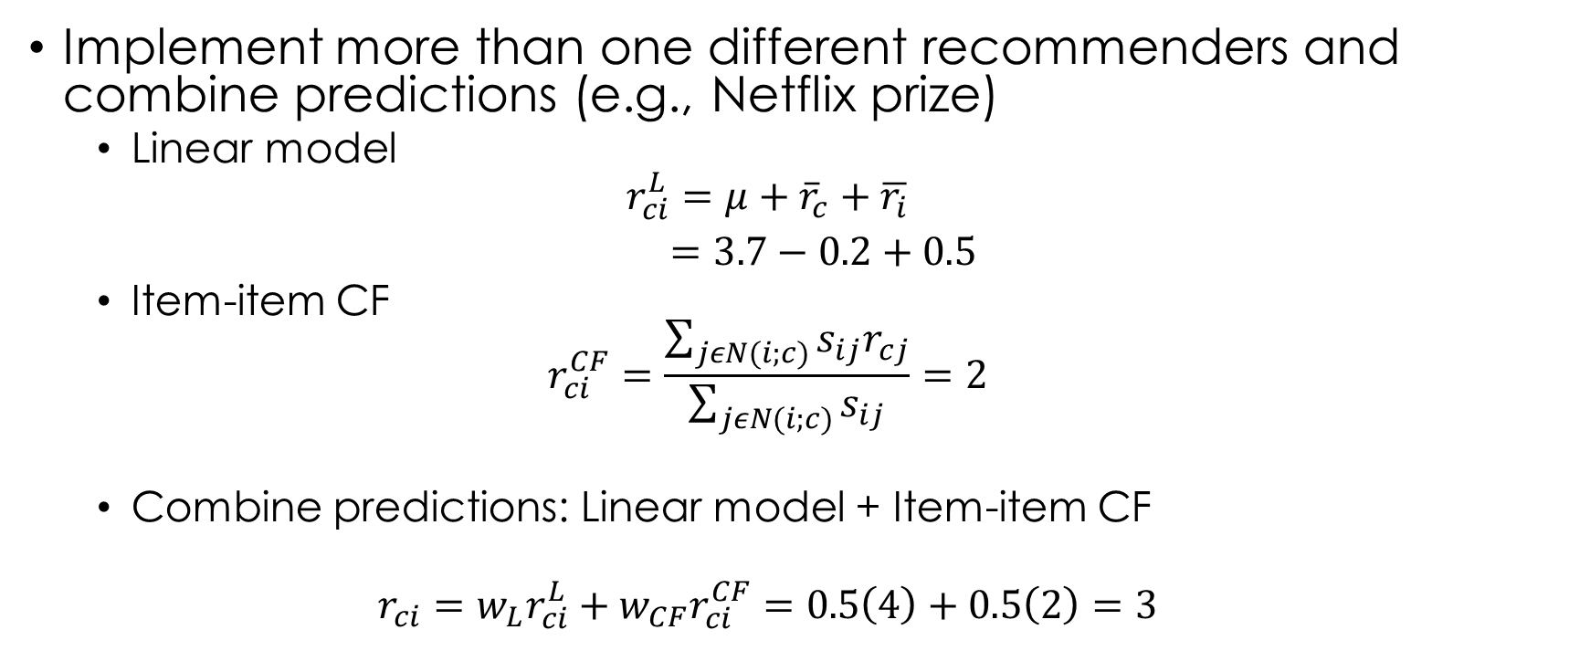
Hybrid methods
Implement more than one different recommenders and combine predictions (e.g., Netflix prize)
Linear model
$$r_{ci}^{L}=μ+{\overline{r}}_{c}+\overline{r_{i}}$$ $=3.7−0.2+0.5$
Item-item CF
$$r_{ci}^{CF}=\frac{\sum_{jεN(i;c)}{s_{ij}r_{cj}}}{\sum_{jεN(i;c)}{s_{ij}}}=2$$
Combine predictions: Linear model + Item-item CF
$$r_{ci}={w_{L}r}_{ci}^{L}+w_{CF}r_{ci}^{CF}=0.5\left(4\right)+0.5\left(2\right)=3$$

Slide 38
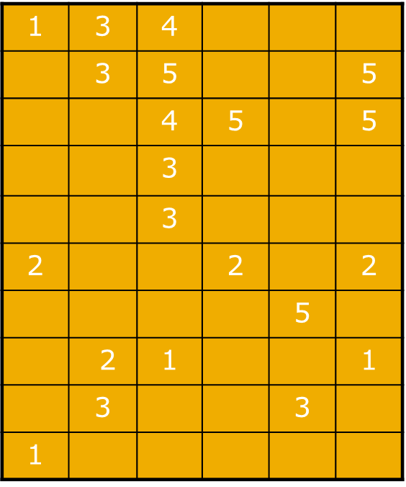
3. How do you evaluate RS?
movies
How well does model predict out-of-sample, in the “test” or validation set.
Why hold out part of the data?
calibration
“training” set
users
? |  | ?
 | ?
 |  | ?
 | ?
validation
“test” set

Slide 39
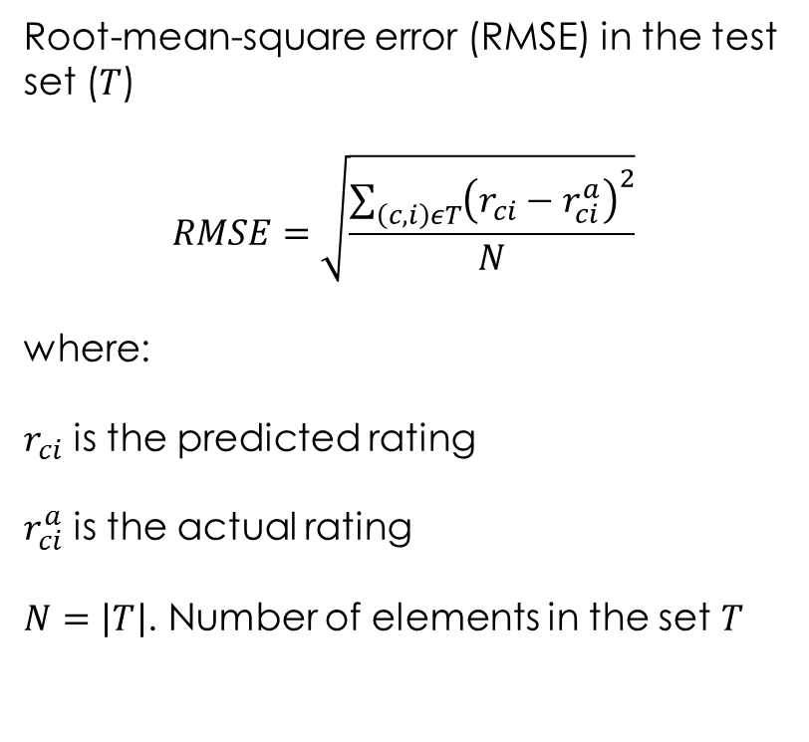
RMSE
movies
Root-mean-square error (RMSE) in the test set ($T$)
$$RMSE=\sqrt{\frac{\sum_{\left(c,i\right)εT}{{\left(r_{ci}−r_{ci}^{a}\right)}^{2}}}{N}}$$
where:
$r_{ci}$ is the predicted rating
$r_{ci}^{a}$ is the actual rating
$N=\left|T\right|$. Number of elements in the set $T$
calibration
“training” set
users
? |  | ?
 | ?
 |  | ?
 | ?
validation
“test” set

Slide 40
Challenges with recommender systems
Why recommend a product the customer was going to buy anyhow?
Consider the counterfactual: what would have happened had the user not seen the recommendation?
Not enough diversity in recommendations
If I like one Harry Potter movie, my recommendations is all Harry Potter movies
I no longer need the product recommended after I buy in the category (preferences change; see Amazon recommendations)

Slide 41
Wrapping up
Using analytics to customize: which product to which customer? (when and over what channel)
Cross-selling, up-selling and recommender systems
Important drivers: product ownership, similarity to others, attributes of products
What is the right objective to maximize: predictions or change in predictions?

Slide 42
References
Bodapati, Anand V. "Recommendation systems with purchase data." Journal of marketing research 45.1 (2008): 77-93.
Shibo Li, Baohong Sun, Ronald T. Wilcox (2005) Cross-Selling Sequentially Ordered Products: An Application to Consumer Banking Services. Journal of Marketing Research: May 2005, Vol. 42, No. 2, pp. 233-239.
Shibo Li, Baohong Sun, Alan L. Montgomery (2011) Cross-Selling the Right Product to the Right Customer at the Right Time. Journal of Marketing Research: August 2011, Vol. 48, No. 4, pp. 683-700.

